Slide 1
How to create effective presentation
By Noshaba Fraz

Slide 2


Slide 3
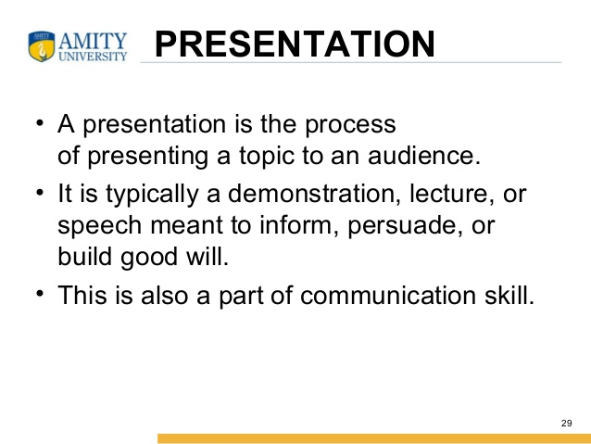
Presentation

Slide 4
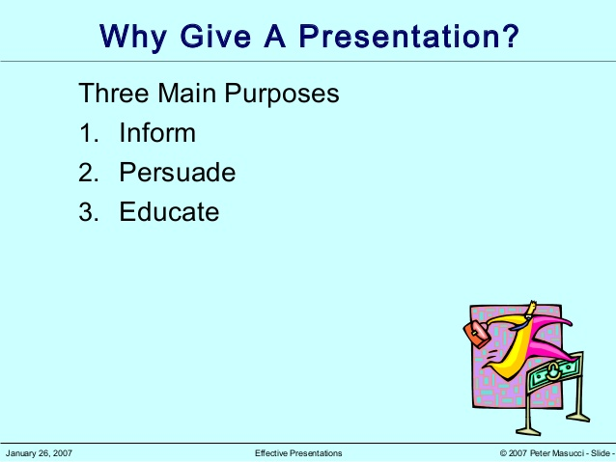
Purpose

Slide 5
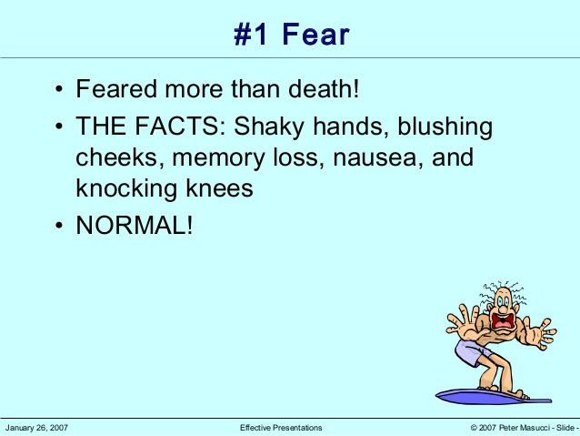
Fear of audience

Slide 6
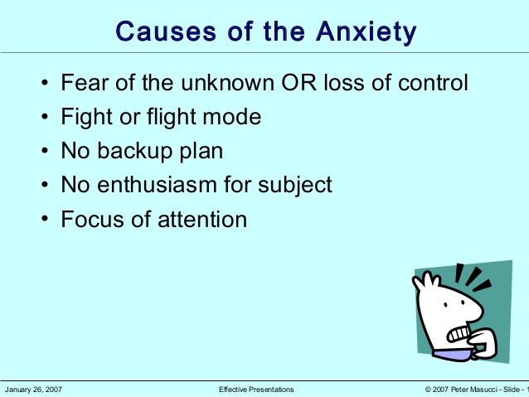
Causes of the anxiety

Slide 7
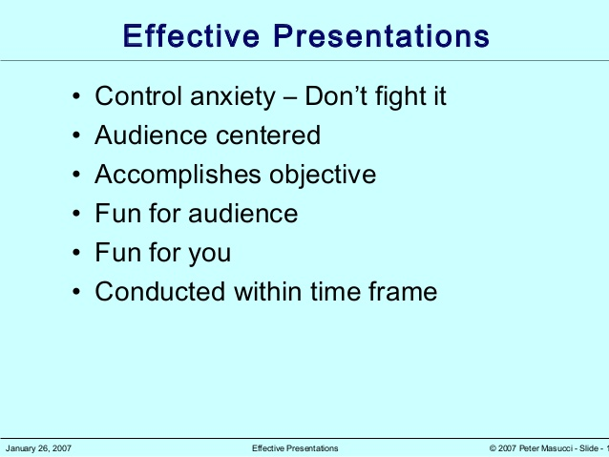
Effective presentation

Slide 8
Steps to create an effective presentation
1. Select a focused topic.
2. Research the topic.
3. Know the audience.
4. Identify learning objectives.
5. Organize the ideas.
6. Outline a narrative storyboard.
7. Sketch a slide storyboard.
8. Simplify the data.
9. Build the presentation, including graphics and videos.
10. Practice.

Slide 9
SIMPLE FORMAT
Selection of topic
determine the audience
Collect the material
Organize the data
presentation

Slide 10
DECIDE AND PLAN
Effective Communication
What do you want to achieve?
• Educate and inform • Inspire/interest and persuade • Entertain • Must grab and hold attention

Slide 11
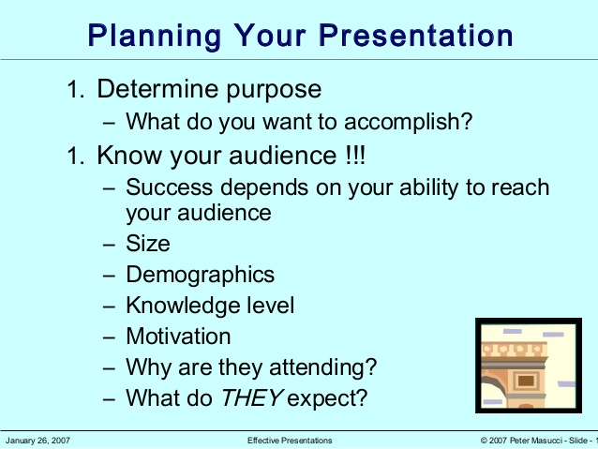
1.Select a focused topic.

Slide 12
3. Know the audience.

Slide 13
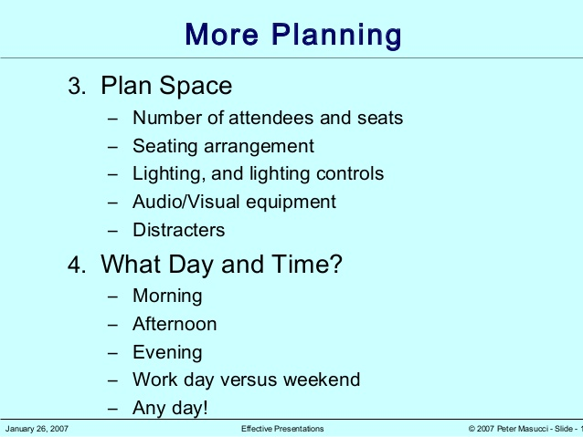
PLANNING

Slide 14
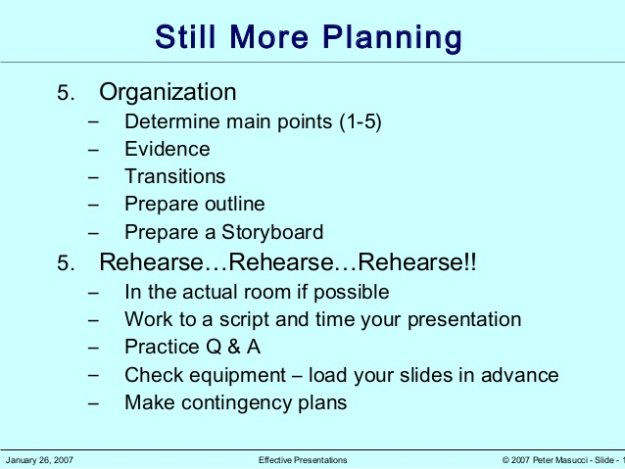
Planning

Slide 15
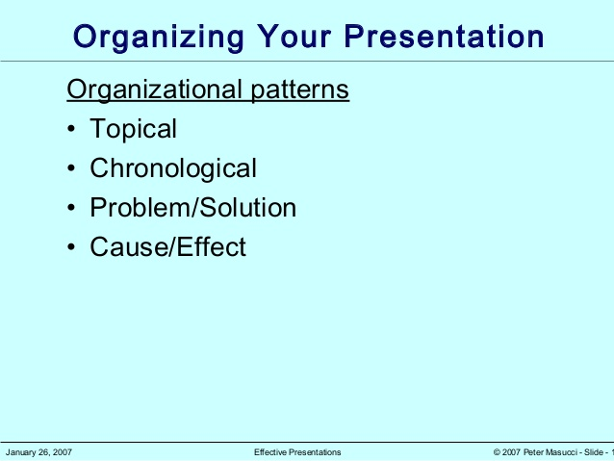
Organizing your presentation

Slide 16
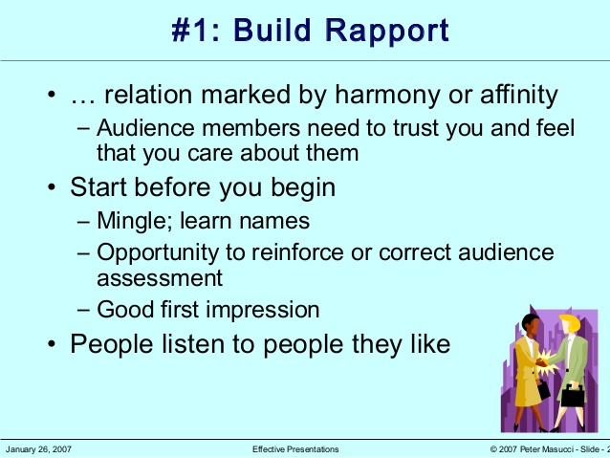
Build Rapport

Slide 17
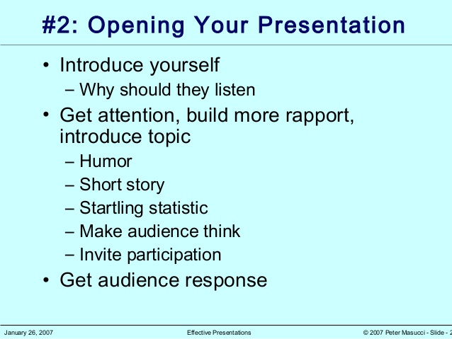
opening yours presentation

Slide 18
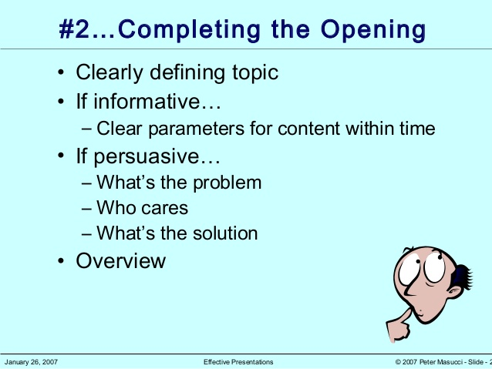
Purpose of a presentation

Slide 19
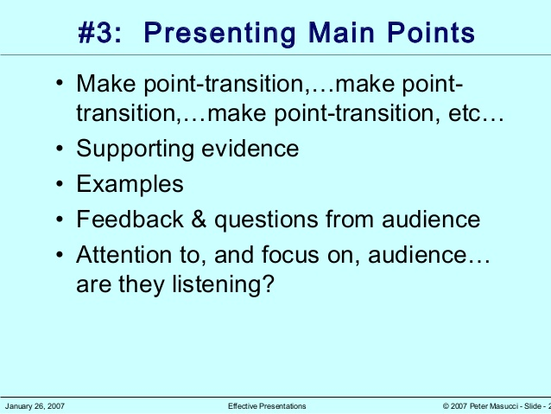
Presenting main points

Slide 20


Slide 21
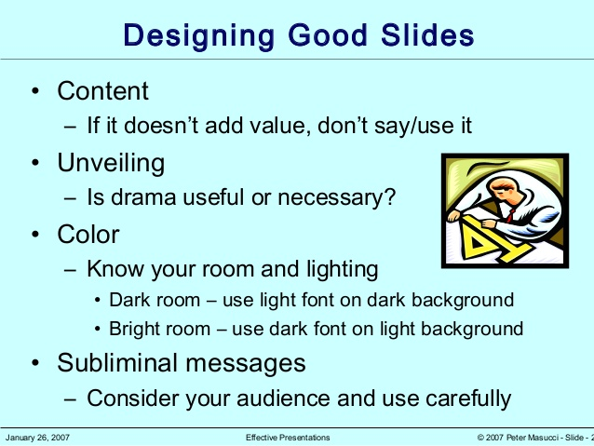
Designing good slides

Slide 22
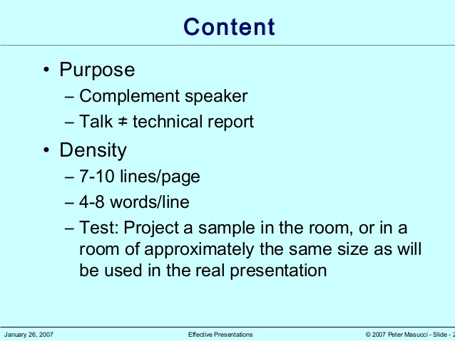
Content

Slide 23
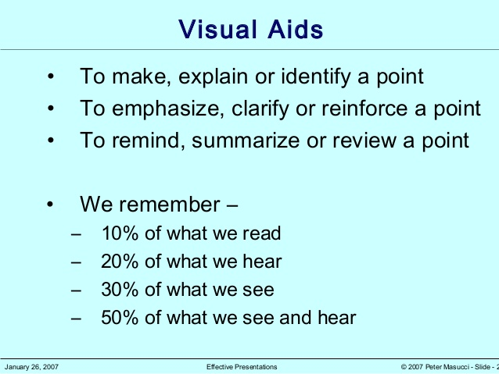
Visual aid effect

Slide 24
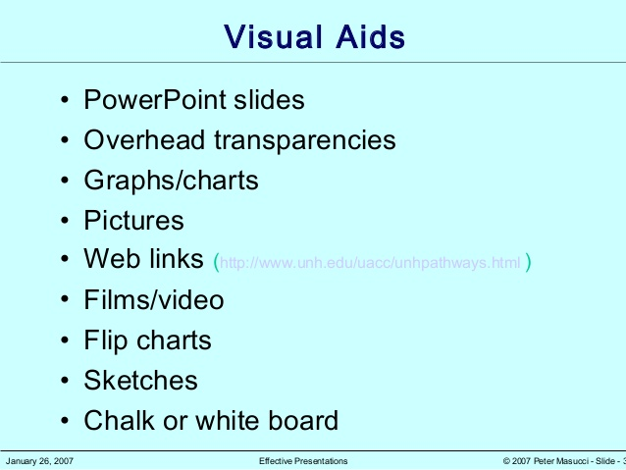
Visual aids

Slide 25
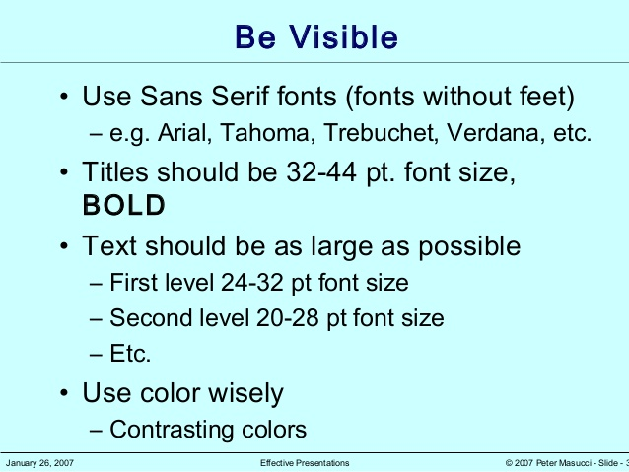
Be visible

Slide 26
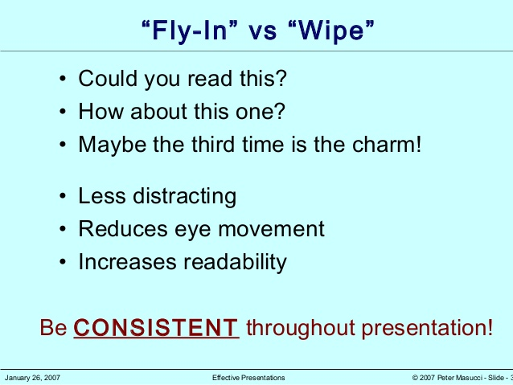
FLY-IN vs wipe

Slide 27
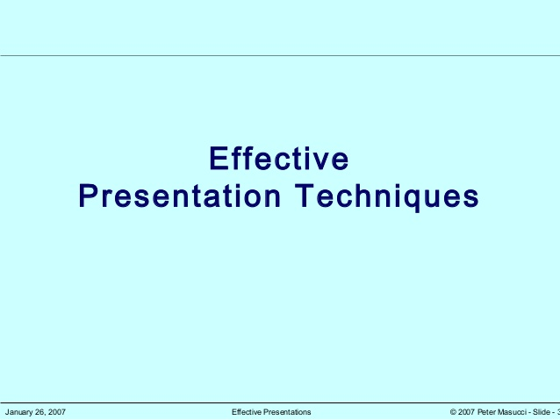

Slide 28
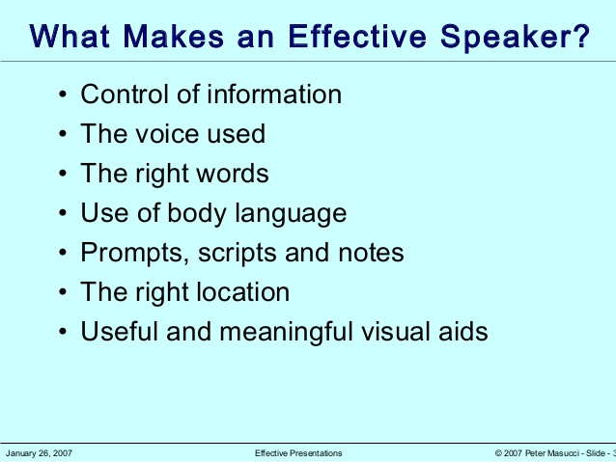
EFFECTIVE PRESENTATION TIPS

Slide 29
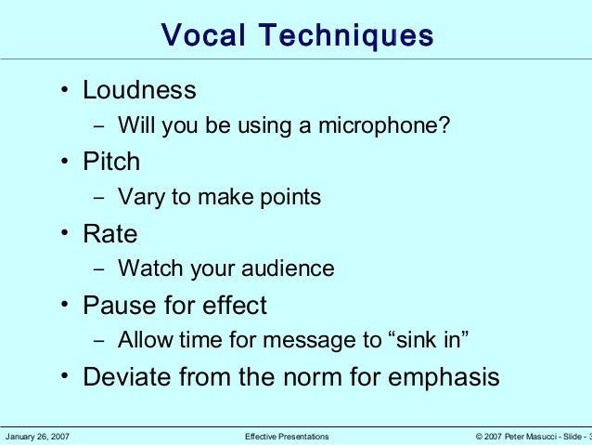
VOCAL TECHNIQUES

Slide 30
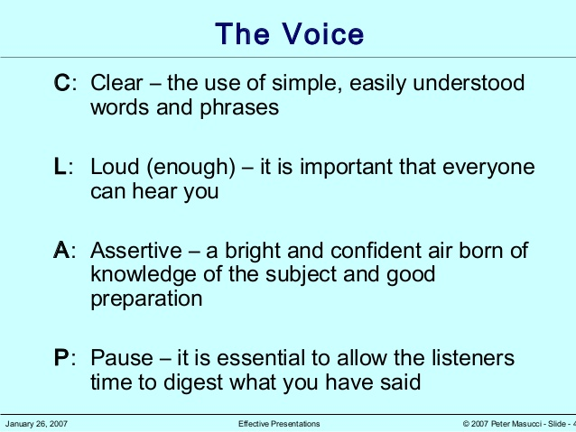
THE VOICE

Slide 31
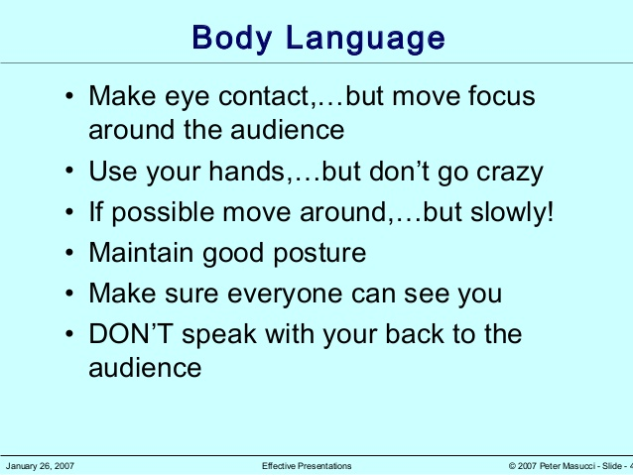
BODY LANGUAGE

Slide 32
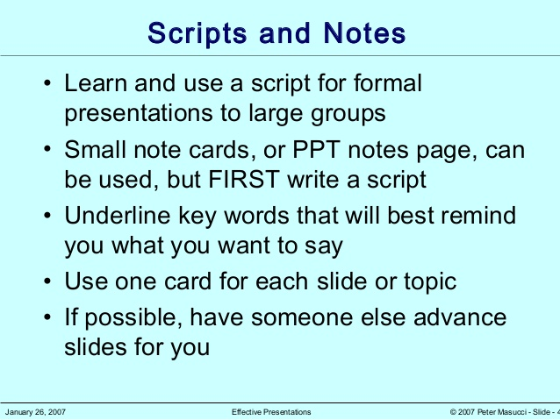
SCRIPTS AND NOTES

Slide 33
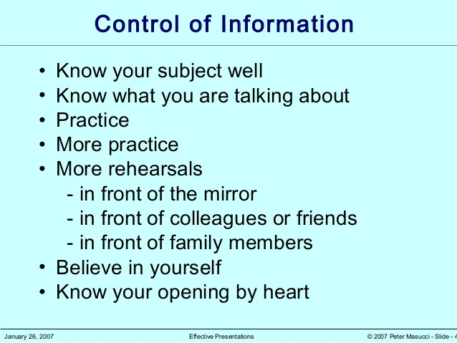
CONTROL OF INFORMATION

Slide 34
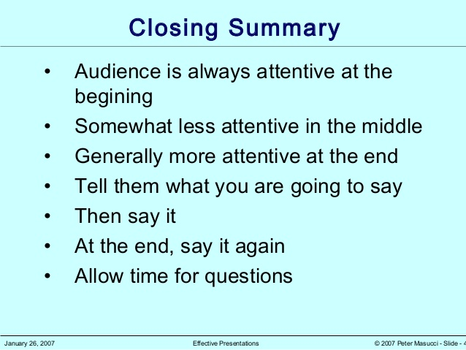
CLOSING SUMMARY

Slide 35
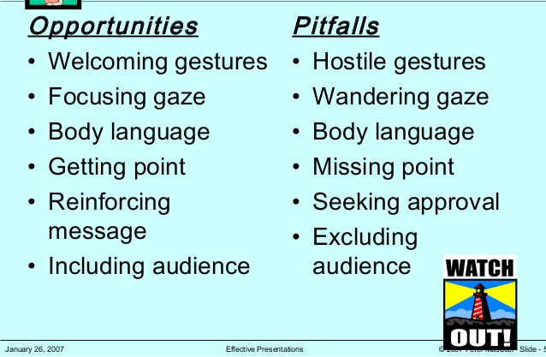
SORT OUT DRAWBACKS

Slide 36
References
Cipolla, R; Department of Engineering, How to prepare and deliver a presentation
http://www.eng.cam.ac.uk/~cipolla
Keltanbach. T, Soetikno.R ; (2016) MENTORING, EDUCATION, AND TRAINING CORNER
Naanki@vocalchord.com.au www.vocalchord.com.au

Slide 37

ANY QUERY

